Slide 1

Maroon 4
Predicting the final four of 2025 NCAA Tournament
March Data Crunch Madness 2025
Gael Mayanza-ouamba
Felipe Chen
Yichen Yang
Yanbing Ren

Slide 2
Methodology
1) Variable Transformation
3) Model Building
We analyzed the differences between team 1 and team 2, and calculated for some.
5 machine learning models and 1 statistical model.
2) Variable Selection
4) Model Evaluation
Using random Forest, 10 variables were chosen based on feature importance for each model.
Random Forest had the lowest log loss and highest accuracy.
Notes:
Felipe

Slide 3





New Features
BPI (Basketball Power Index)
1
Source
Measure of the team strength that is meant to be the best predictor of performance going forward.
W/L % Coach
2
Reflects a coach historical win-loss record, capturing their impact on team success.
Top Player Influence
3
Measures how heavily a team relies on its top player.
extrêmement froid
Adjusted Shooting %
4
Adjusted weights for 2P%, 3P%, and FT% to better reflect scoring efficiency.
Combined Fatigue
5
Measure how fatigue influences player performance.

Slide 4
Variable transformation
Difference is found for most independent variables: team1 minus team 2.
Only except for num_over_time (for each game, team 1 and team 2 have the same value).
Combined_Fatigue
Top_Player_Influence
Score = ∑ (feature_importance_i × feature_value_i), for i = 1 to n
Where:
feature_value_i = 1 if the team has the player who is in top 100 playlist, feature_value_i = 0 otherwise
(travel distance /1000) + abs(jet lag)
Adjusting Shooting %
(fg2pct * IF(f3grate > avg(f3grate(all_teams)), 0.3, 0.4) + fg3pct * IF(f3grate > avg(f3grate(all_teams)), 0.6, 0.5) + ftpct * 0.1)
Feature (for calculating top player influence)
assit_to_turnover; block_per_foul; defensive_plays_per_foul; defensive_rebounds etc.

Slide 5
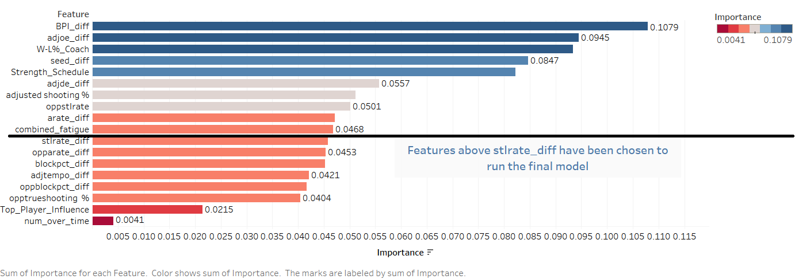
Variable Selection
Predictor Importance
Top 10 Variables
BPI_diff
adjoe_diff
W-L%_Coach
seed_diff
Strength_Schedule
adjde_diff
adjusted shooting %
oppstlrate
arate_diff
combined_fatigue
Used Random Forest to select the top 10 variables that have significant explanatory power
Notes:
Felipe

Slide 6
Model building
Gaussian Naive Bayes
1
2
XG Boosting
Random Forest
3
4
Logistics Regression
Bayesian Logistic Regression (statistical model)
Support Vector Machine
5
6
Notes:
Gael

Slide 7
Validation Method
Expanding Window
Reason
Create a model that can reflect the real-world scenario.
Backtest
Training 1
Test 1
Variables reflecting NCAA Tournament games’ performance are dependent on time.
Assumption 1
Training 2
Test 2
Assumption 2
The patterns within variables in 2024 are similar to those in 2025.
Training 3
Test 3
Training 4
Test 4
Assumption 3
The patterns within variables in 2024 and 2023 are similar to those in 2025.
Notes:
Felipe

Slide 8




Steps for Choosing Best Model
Step 1
Fine-tune each model with hyperparameters
Step 3
Choose the best expanding window size for each model by using log loss and accuracy
Step 2
Compare each model by using the log loss and accuracy

Slide 9
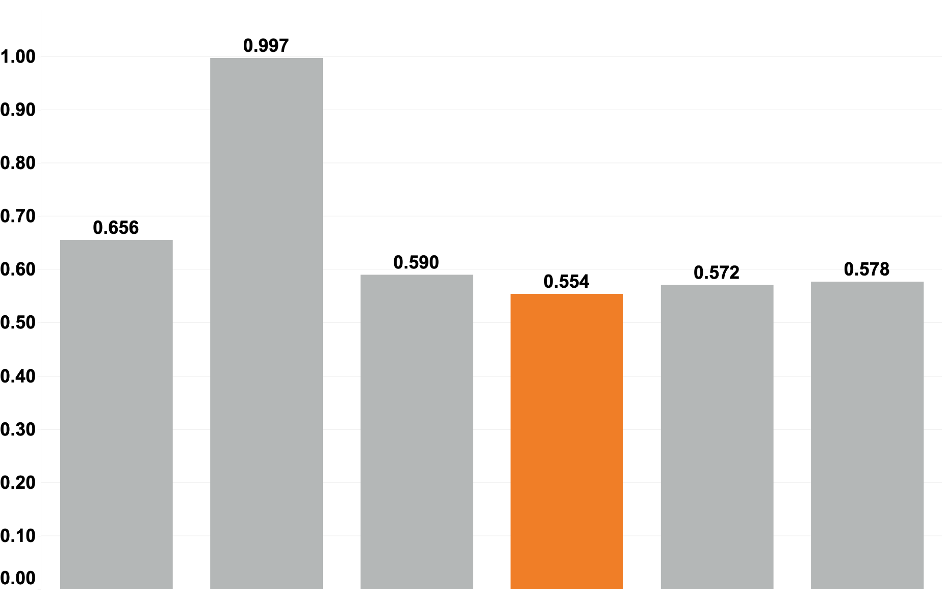
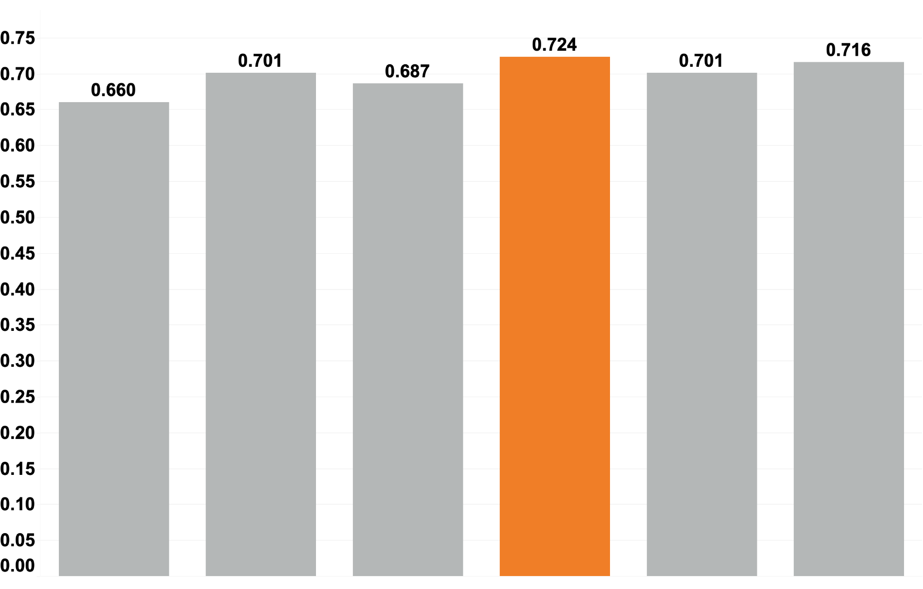
Model Evaluation
LOG LOSS
Accuracy
Bayesian Logistic Regression
Gaussian Naive Basas
Logistic Regression
Random Forest
Support Vector Machine
XG Boosting
Bayesian Logistic Regression
Gaussian Naive Basas
Logistic Regression
Random Forest
Support Vector Machine
XG Boosting
Out of six models tested, Random Forest performed the best based on log loss and accuracy.

Slide 10




Final Four
Auburn
Duke
58%
76%
Florida
Duke
58%
Florida
Tennessee

Slide 11
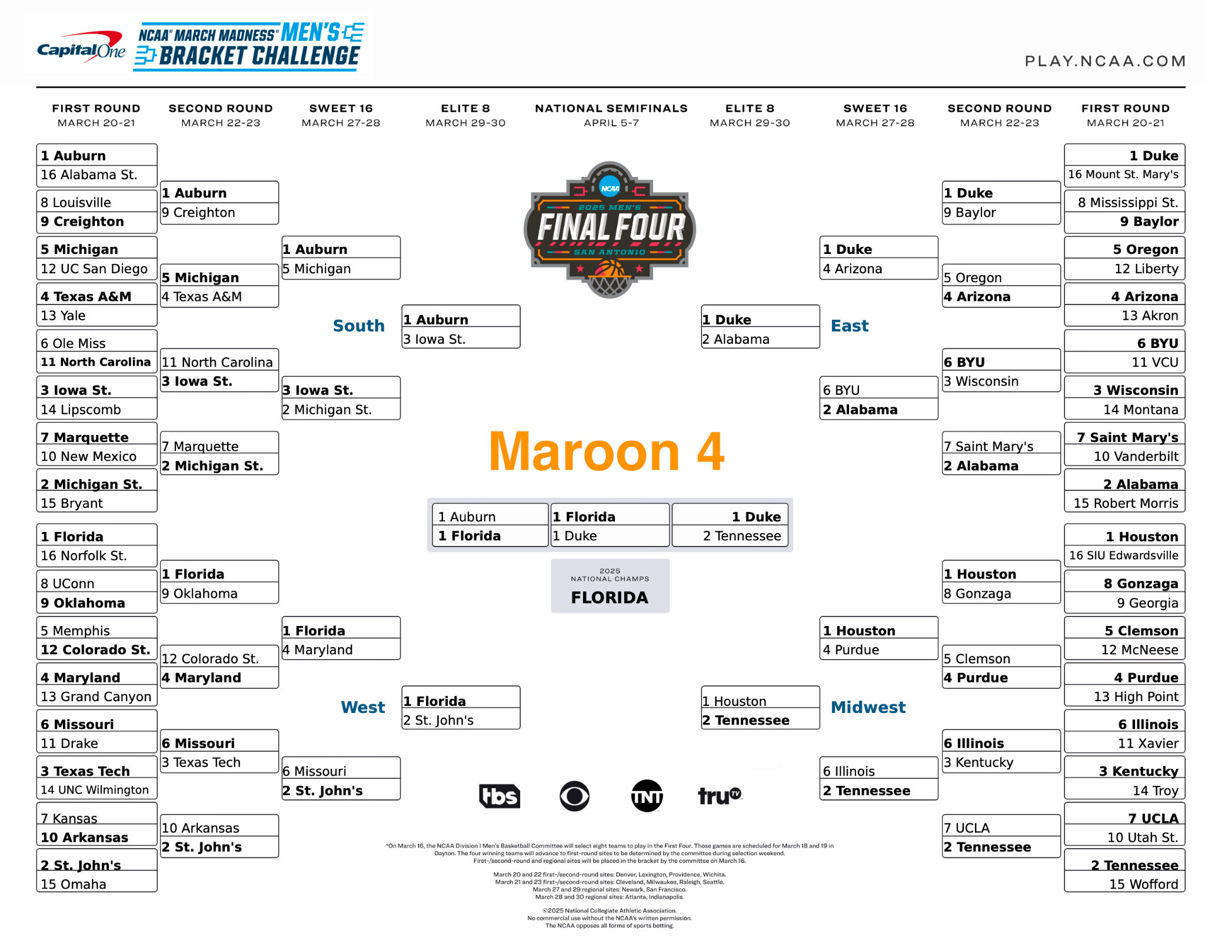

Slide 12

Thank You!
Let’s Go Gators!
Maroon 4

